Slide 1
Posttranscriptional Regulation of Gene Expression
Although transcriptional control is the major type of regulation in eukaryotes, posttranscriptional regulation also occurs in many organisms.
Examples include alternative splicing and RNA-mediated gene silencing.

Slide 2
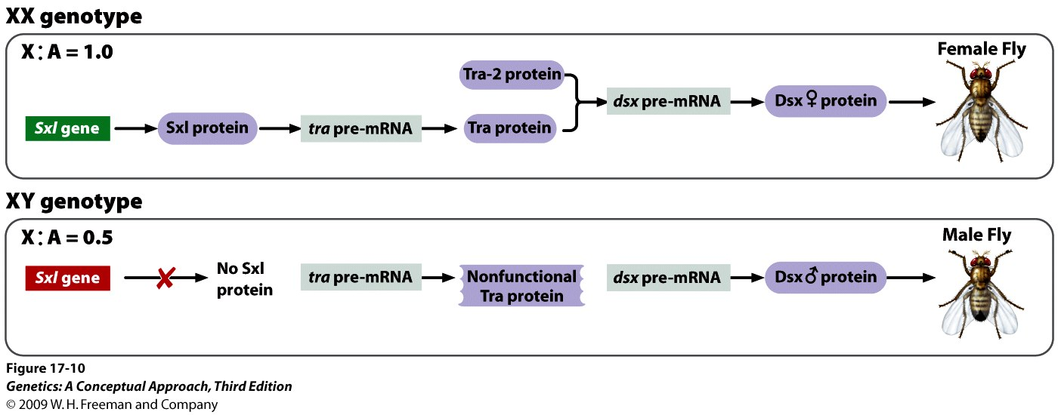
Sex determination in Drosophila
Notes:
Figure 17.10 Alternative splicing controls sex determination in Drosophila.

Slide 3
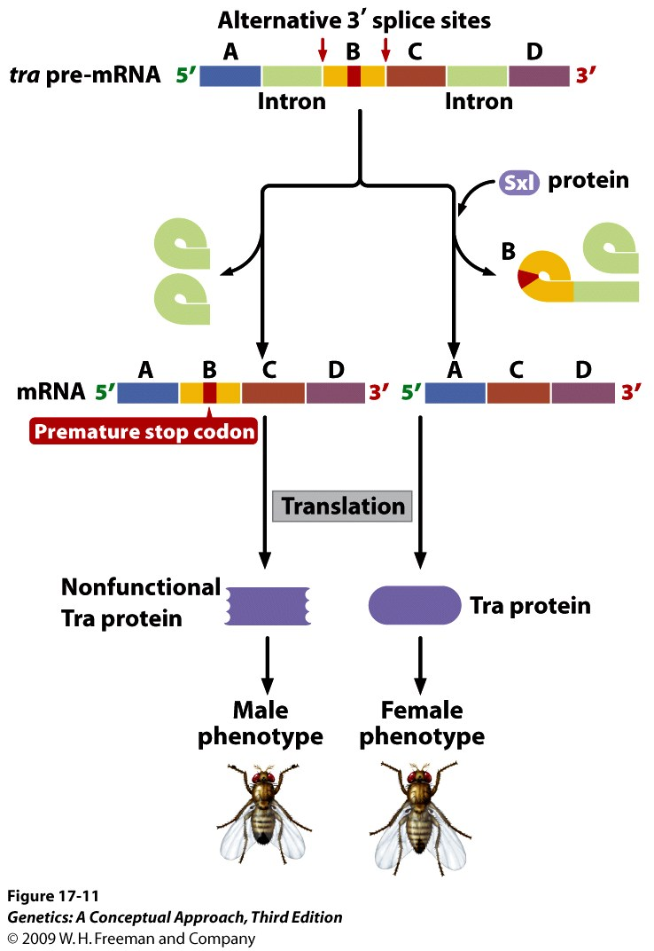
Notes:
Figure 17.11 Alternative splicing of tra pre-mRNA. Two alternative 3′ splice sites are present.

Slide 4
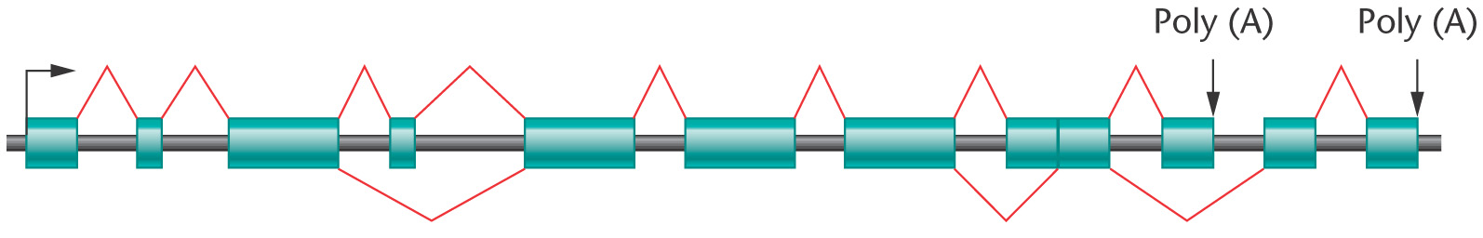
Alternative splicing can generate different forms of mRNA from a pre-mRNA, giving rise to a number of proteins from one gene. As a result, the number of proteins that a cell can make (its proteome) is not directly related to the number of genes in the genome.
Notes:
Figure 17-21 Patterns of alternative splicing in a eukaryotic mRNA. Exons are represented by cylinders. The normal splicing pattern is shown above the exons; alternative patterns of splicing are shown below the exons. Note that alternative splicing can add exons and a new poly (A) site. Alternative splice sites are often used in multiple combinations, resulting in many different mRNAs from a single transcript.

Slide 5
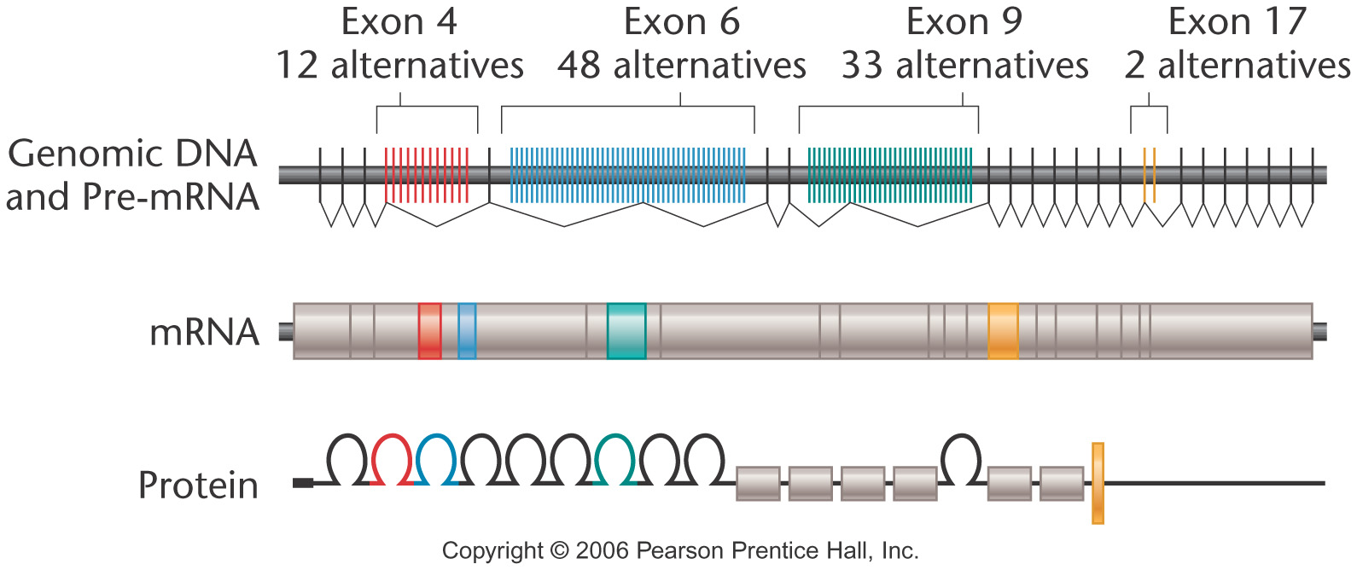
Drosophila Dscam locus
12 x 48 x 33 x 2 = 38,016! Yet the fly genome contains only ~13,000 genes.
Notes:
Figure 17-23 (Top) Organization of the Dscam gene in Drosophila melanogaster and the transcribed pre-mRNA. Each mRNA will contain one of the 12 possible exons for exon 4 (red), one of the 48 possible exons for exon 6 (blue), one of 33 for exon 9 (green), and one of 2 for exon 17 (yellow). If all possible combinations of these exons are used, the Dscam gene can encode 38,016 different versions of the DSCAM protein.

Slide 6
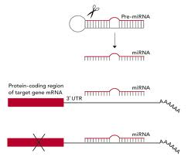
MicroRNAs
RNA-mediated gene silencing
MicroRNAs (miRNAs) mediate RNA silencing by binding to the 3' untranslated regions of mature mRNAs to block translation.

Slide 7
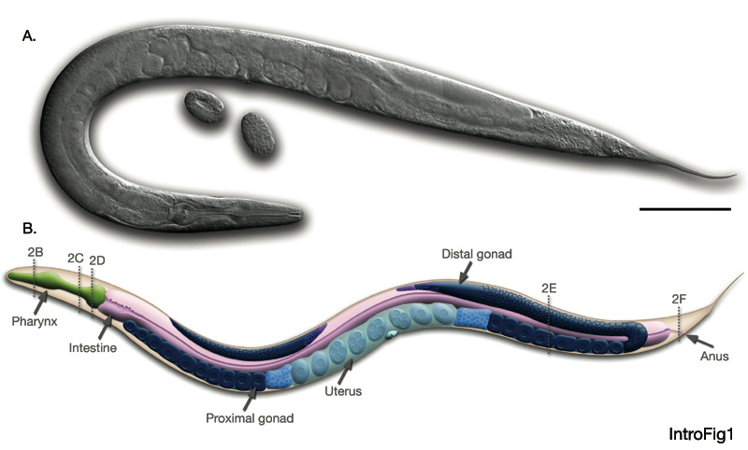
C. elegans

Slide 8
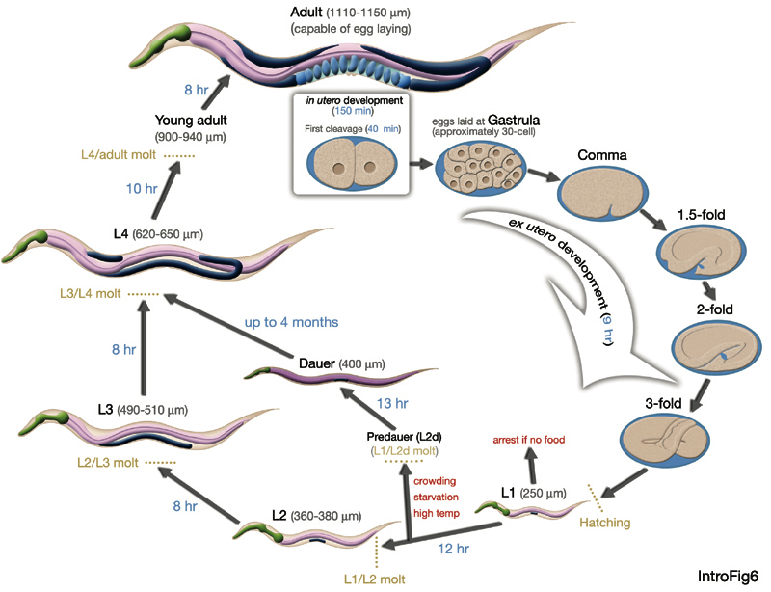
C. elegans life cycle

Slide 9
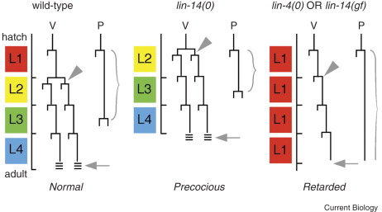
Heterochronic mutants

Slide 10
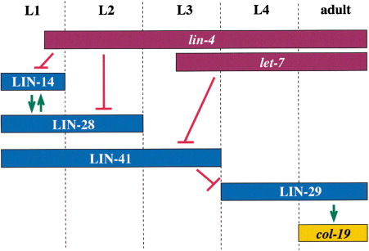
lin-4 negatively regulates lin14

Slide 11
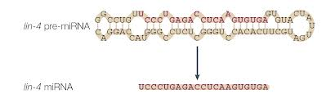
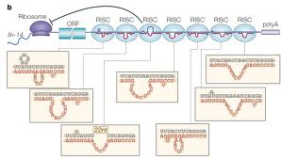
lin-4 is a microRNA

Slide 12
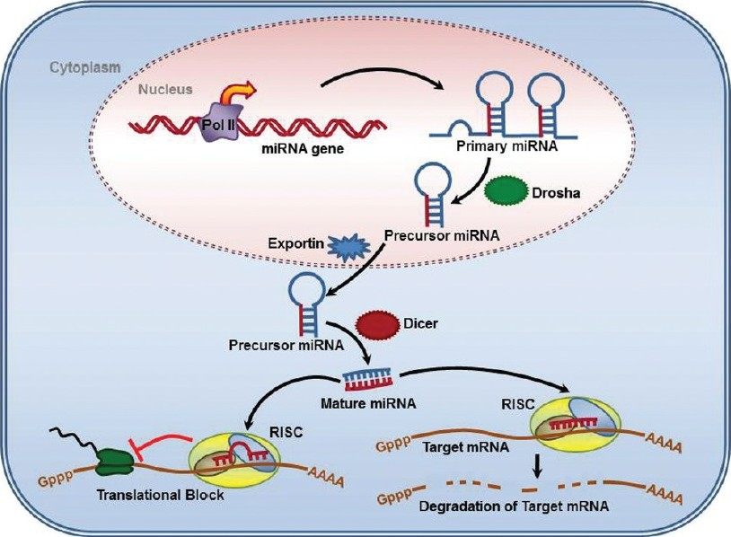
MicroRNA biogenesis

Slide 13
Degrading mRNA by siRNA
RNA-mediated gene silencing
Gene silencing by RNA interference (RNAi) uses a protein called Dicer to cleave double-stranded RNA molecules into short interfering RNAs (siRNAs).
siRNAs bind to the RNA-induced silencing complex (RISC complex) for unwinding.
The single-stranded RNAs target mRNAs with complementary sequences to mark them for degradation.

Slide 14

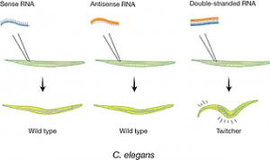
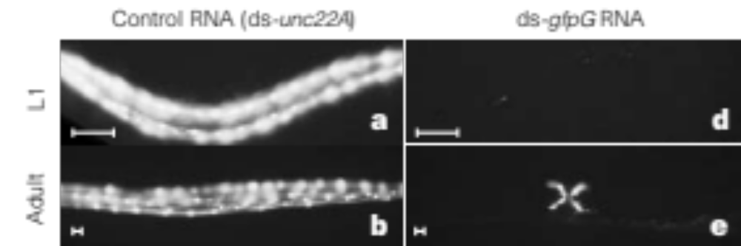
Andrew Fire and Craig Mello

Slide 15
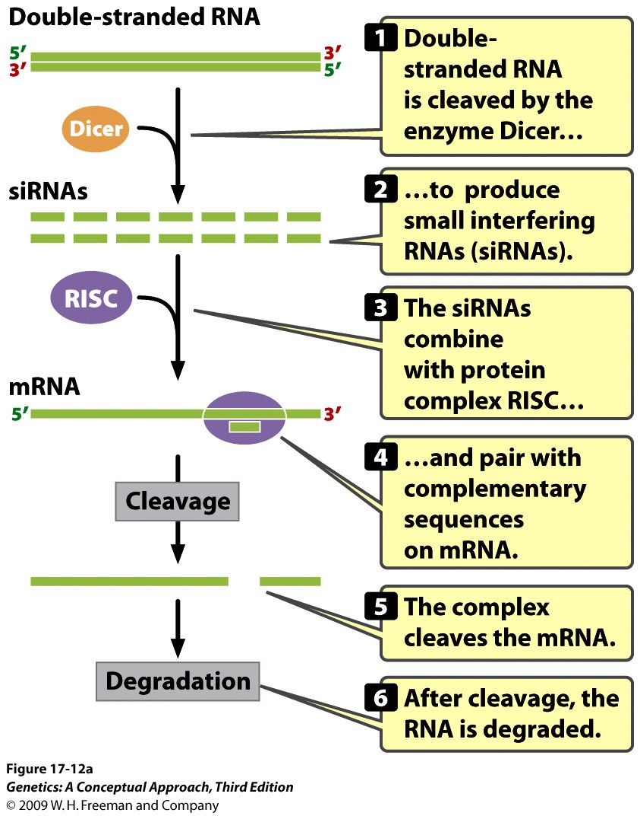
siRNA biogenesis
Notes:
Figure 17.12a RNA silencing leads to the degradation of mRNA, or the inhibition of translation or transcription. Small interfering RNAs (siRNAs) degrade mRNA by cleavage.

